Slide 1
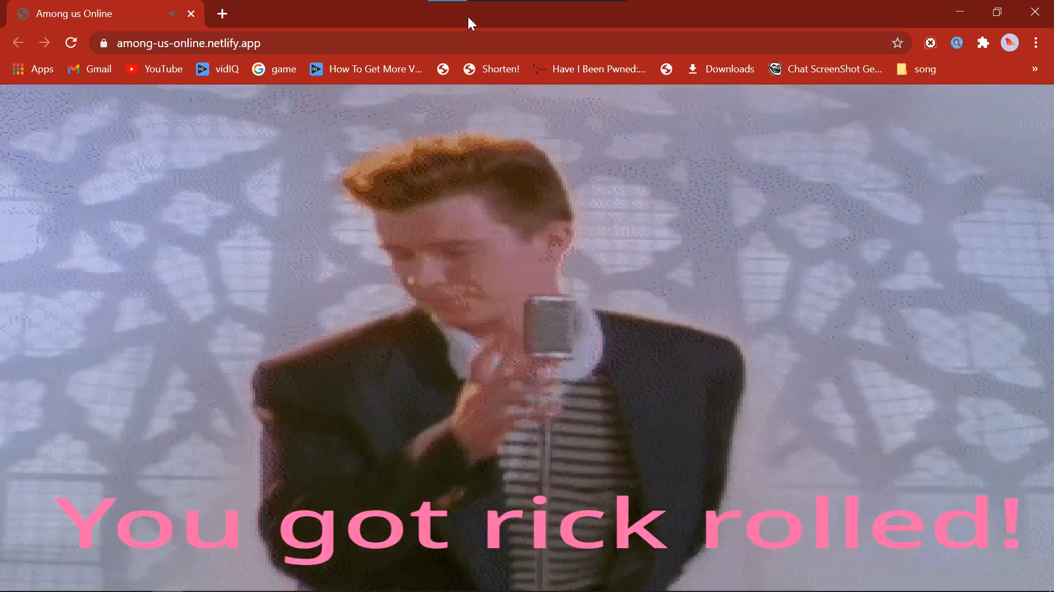



Online
Home Play Steam Settings Account
Continue in the given settings
Try
Play
Play
More options coming soon..
Welcome TRSC25!
(No multiplayer)

Slide 2


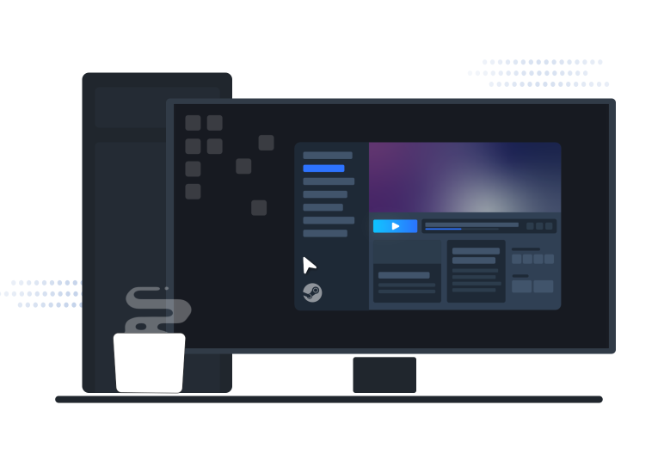

Online
Home Play Steam Settings Account
SIGN IN
Join Steam and discover thousands of games to play.
Continue in the given settings
Try
Steam account name
Password
Forgot your password?
Play
Logging in to Steam™
Can help you retrieve the
Purchases you have made
For Among Us, like skins,
Pets, Bundles,
Play
More options coming soon..
Welcome TRSC25!
(No multiplayer)
It's free and easy to use.
Join Steam

Slide 3
Online
Home Play Steam Settings Account
SIGN IN
Join Steam and discover thousands of games to play.
Continue in the given settings
Try
Steam account name
Password
Forgot your password?
Logging in to Steam™
Can help you retrieve the
Purchases you have made
For Among Us, like skins,
Pets, Bundles,
Play
More options coming soon..
(No multiplayer)
It's free and easy to use.
Join Steam

Slide 4

TRSC25
fakemanwhodoesnotexist@gmail.com
Joined Among Us Online on Jan 6 2021 (2 months ago)
Played 11 minutes
Online
Home Play Steam Settings Account
Work In Progress
Come back again later
Name: TRSC25
Email: fakemanwhodoesnotexist@gmail.com
Password: ************
Alternate Email: Not Set

Slide 5
Online
TRSC25
fakemanwhodoesnotexist@gmail.com
Joined Among Us Online on Jan 6 2021 (2 months ago)
Played 11 minutes
Home Play Steam Settings Account
General
Profile
Connected accounts
Danger zone
Security
Name: TRSC25
Email: fakemanwhodoesnotexist@gmail.com
Password: ************
Alternate Email: Not Set
Google
Not Connected
Not Connected
Not Connected
Not Connected
Steam
Twitch
Facebook

Slide 6
Online
TRSC25
fakemanwhodoesnotexist@gmail.com
Joined Among Us Online on Jan 6 2021 (2 months ago)
Played 11 minutes
Home Play Steam Settings Account
Why connect?
Connecting accounts can help make the sign in procedure fast.
General
Profile
Connected accounts
Danger zone
Security
Google
Name: TRSC25
Not Connected
Not Connected
Not Connected
Not Connected
Steam
Email: fakemanwhodoesnotexist@gmail.com
Twitch
Password: ************
Facebook
Alternate Email: Not Set
Irreversible and destructive actions
Delete User
Once you delete your user ,there is no going back .Please be certain.

Slide 7
Online
TRSC25
fakemanwhodoesnotexist@gmail.com
Joined Among Us Online on Jan 6 2021 (2 months ago)
Played 11 minutes
Home Play Steam Settings Account
Why connect?
Connecting accounts can help make the sign in procedure fast.
Irreversible and destructive actions
General
Profile
Connected accounts
Danger zone
Security
Delete User
Once you delete your user ,there is no going back .Please be certain.
Google
Not Connected
Not Connected
Not Connected
Not Connected
Steam
Twitch
Facebook
Two-factor authentication
Enable two-factor authentication to add an extra layer of security to your account. Use an application such as Authy, 1Password, LastPass or Google authenticator to get an authorization code when prompted
Learn more in the docs

Slide 8
Online
TRSC25
fakemanwhodoesnotexist@gmail.com
Joined Among Us Online on Jan 6 2021 (2 months ago)
Played 11 minutes
Home Play Steam Settings Account
Two-factor authentication
Enable two-factor authentication to add an extra layer of security to your account. Use an application such as Authy, 1Password, LastPass or Google authenticator to get an authorization code when prompted
Learn more in the docs
Irreversible and destructive actions
General
Profile
Connected accounts
Danger zone
Security
Delete User
Once you delete your user ,there is no going back .Please be certain.

Slide 9

